Slide 1
P.E.S
Modern College of Arts Science and Commerce,
(Business Administration Campus)
Shivaji nagar Pune-411005
Project Topic:- “Fitness Center and products order system”
Project Member:- 1) Ayush Kabra Div:- B
2) Kajal Suryawanshi Div :- B
Project Guide:- Prof.Shridevi Pawar

Slide 2
Agenda
System Overview.
Technologies Used.
Problem definition.
Limitation of manual system.
Proposed System:
Advantages of proposed system.
List of processes within system.
Design Specification:
Entity Relationship diagram
Context Level Data flow Diagram
First Level Data Flow Diagram
Input Screen
Features of the System.
Advantages & Limitation.
Future Enhancements.

Slide 3
System Overview
This system is mainly designed for the making member registration into fitness center and managing their enquiry details
Packages are divided into individual or combo according to the required and fees are charged and later received.
Batch, Routine and diet are decided by the trainer and dieticians help
The member profile is created and progress is traced
Members can quickly register any complaint for any problem occurred ,get required feedback.
This system reduces the complexity and documentation work. Here there is no need of maintaining the registers.
It will maintain data and salary of employee and details of trainers, dieticians, etc
Authorize access for data is provided.

Slide 4
Technologies Used
HARDWARE AND SOFTWARE SPECIFICATION
HARDWARE PLATFORM:
MICROPROCESSOR: PENTIUM III AND ABOVE
RAM : 256 AND ABOVE
HDD : 40 GB AND ABOVE
SOFTWARE PLATFORM:
FRONTEND TOOL : Java
BACKEND TOOL : ACCESS
OPERATING SYSTEM : WINDOWS XP/VISTA/2003
AND ABOVE

Slide 5
Problem Definition
The present system is able to make searching process easier and storing data in more secure way as it is uses centralised database.
The current system manually keeps all data related to Members, Profile, Package, Enquiry, Employee & Salary details, Routine, Diet, Fees and Fees Receipt details etc that are required in exchange routine transactions
We can interact with members and can solve their complaints and give feedback without much time requirement.
The system provide automated fees and fees receipt entry process of member and also communication with entities like Trainer, Dieticians, etc.

Slide 6
Limitation of Manual System
It is difficult to maintain data and salary of employee and handle expenditure.
Searching of particular record gets time consuming.
Too much documentation work is needed in order to maintain record.
Time limits for member’s interactions with the administration.
Member’s complaint registration and services gets time consuming .
Less secured as data is not authorized.

Slide 7
Proposed System
The proposed system is highly secured because it provide verification for accessing system to avoid unauthorized access
Provide proper enquiry and registration of members according to their packages.
This system will specifically focus on the member health progress with the help of graphs as per their routine physique check-ups so as to show the necessary change to be made to change in routine and diets.
This system will have centralized database.
Maintains member information as per the required area of interest of the member (Yoga, Gym, Aerobics, etc).
Maintains employee registration and their salary details.
This system handles equipment management and day to day expenses required to serve the club members.

Slide 8
Objectives of the Proposed System:
To make proper enquiry and registration of packages like gym, yoga, aerobics or sports or combine packages along with the diet plans
To keep proper update record of master data such as staff, supplier and members with their daily transactions.
To keep updating of services like equipment management, electricity bills, maintenance details, advertisement bills etc.
To provide track of time to time employee work time, and make scheduling.
To Maintain all the package and income details with report for all criteria and transactions
To provide members with their progress card after every 15 days.
To calculate and compute transactions as it is based on various parameters bills and payments of supplier and member fees and package with membership details.
To maintain record of all employees like manager, dieticians, trainers, workers, etc along with their salary
To facilitate the user to generate accurate, timely and neat reports.

Slide 9
List of Process Within System
The project is basically proposed to computerize the existing system so as to gain accuracy, processing speed, data consistency, and data integrity. Software for complete management of gym, aerobic, health and other sport clubs. This all in one solution helps to track the work in a fitness center: track member visits, sales, create various fitness packages and services, track employee work time, and make scheduling. The proposed system mainly covers the following points:
Master Maintenance: Under this module the system maintains all the details of operations, processes and transactions. It also maintains members, packages, progress, employees, supplier and equipment details.
Enquiry Process: Under this module the system maintains enquiry details of the customers who want to become members of center with their area of interest
Registration Process: This module adds new member details. It also record employee details along with manager details.
Equipment management Process: This process maintains all equipment details of suppliers along with their various type also this

Slide 10
List of Process Within System
module provides information about various suppliers along with their name, addresses, contact no. email etc.
Stock updation process: This process includes all details of stock available along with its maintenance details.
Scheduling details: This module will provide the details of the batches of the members according to the packages chosen and also the schedule of work time of employees.
Outsourcing details: This module gives information about the daily or monthly expenses of outsourcing various services like cleaning and maintenance of gym providing with healthcare doctors advisors and seminars.
Progress details: This module will provide the details about the member’s progress after a period of time.
Charges details: This module gives details about the charges that are applied for different packages or services.
Feedback Process: This module provides the information about the feedback from the members for the services provided.
Report Generation: This module will give required information of documentation. And also will help to make any modification, improvement where required by generating monthly/yearly reports.

Slide 11
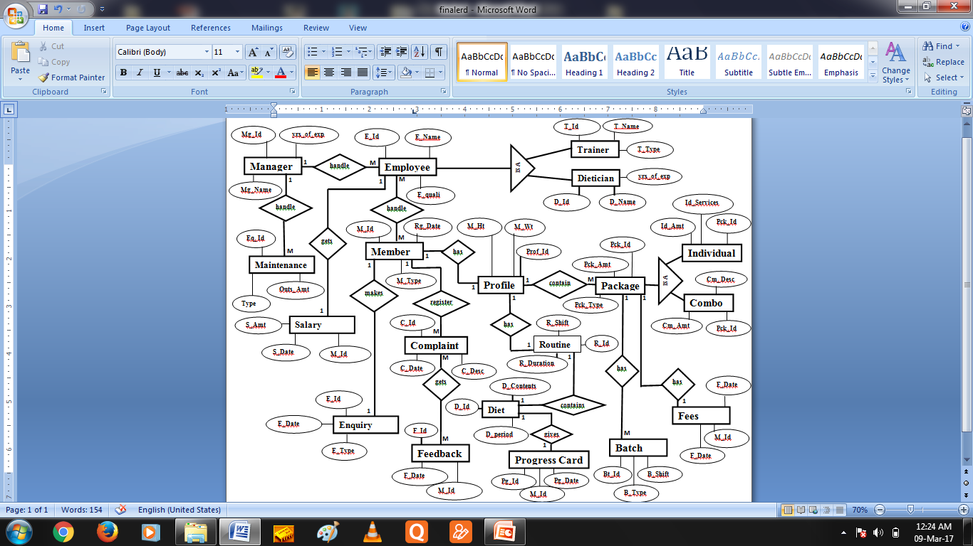
Entity-Relationship diagram

Slide 12
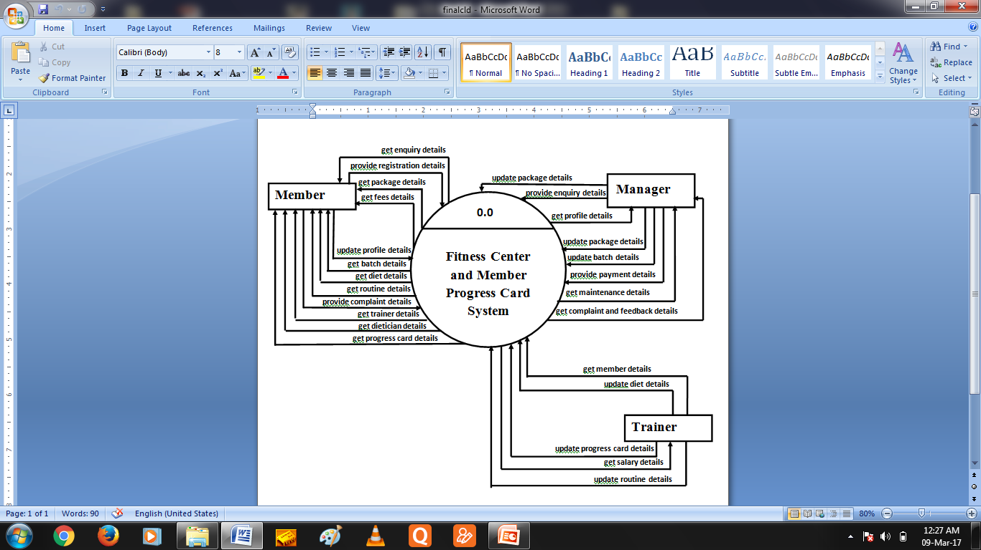
Context Level Diagram
Notes:
Cotext Level Diagram

Slide 13
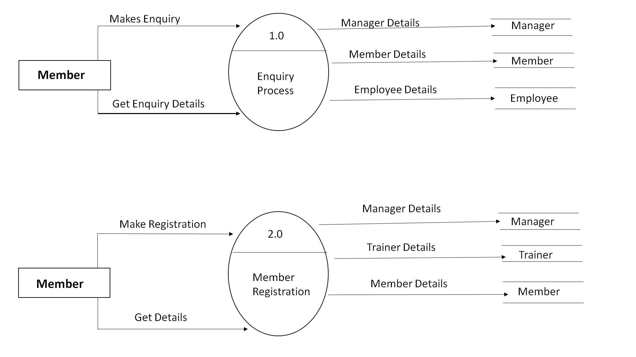
First Level Data Flow Diagram

Slide 14
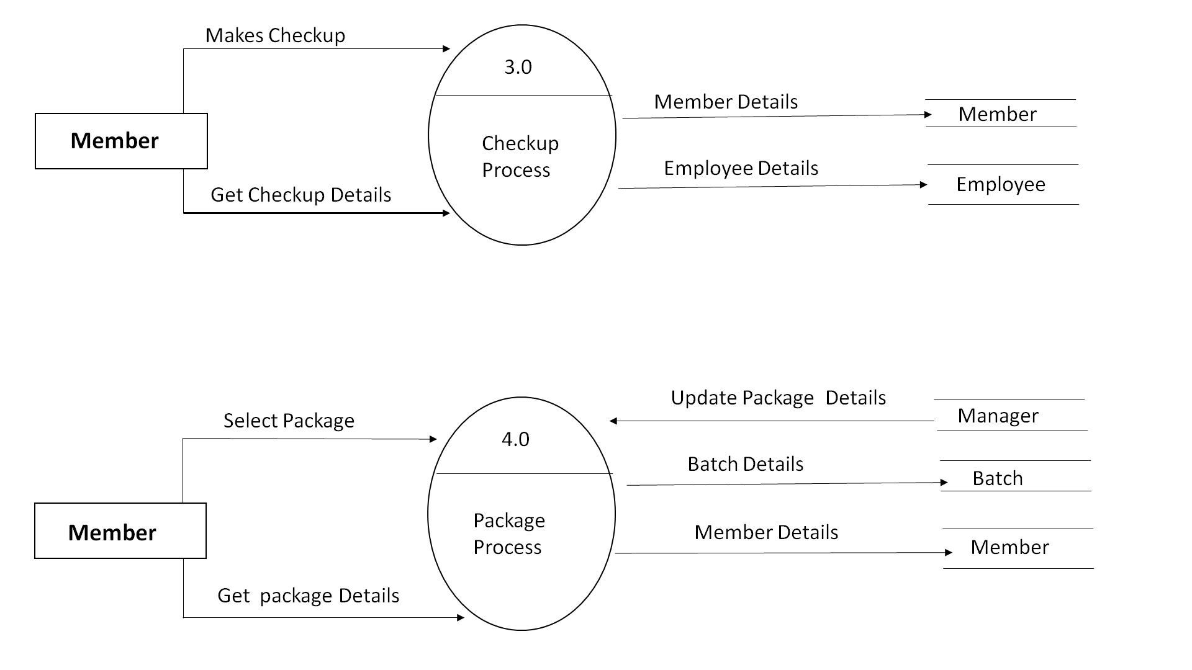
First Level Data Flow Diagram

Slide 15
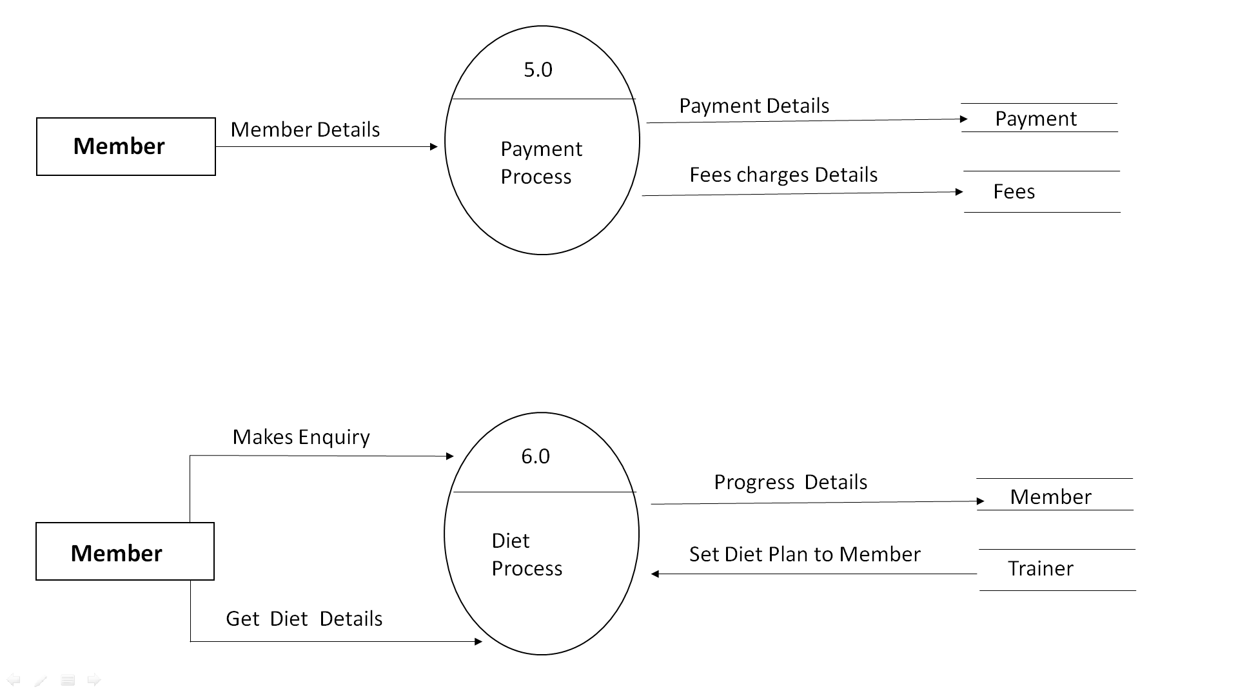
First Level Data Flow Diagram

Slide 16
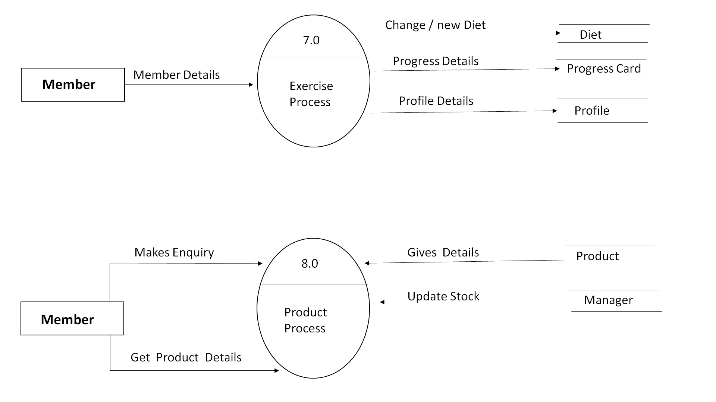
First Level Data Flow Diagram

Slide 17
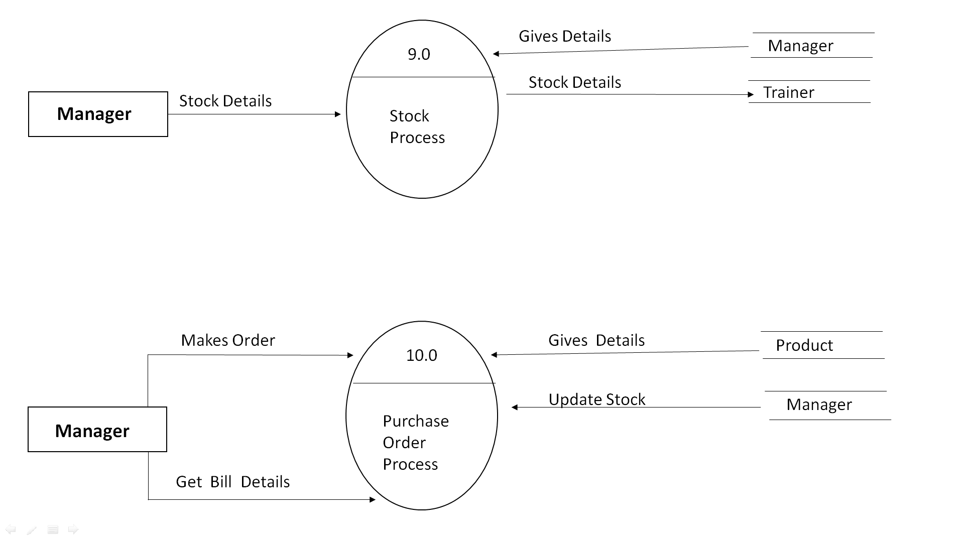
First Level Data Flow Diagram

Slide 18
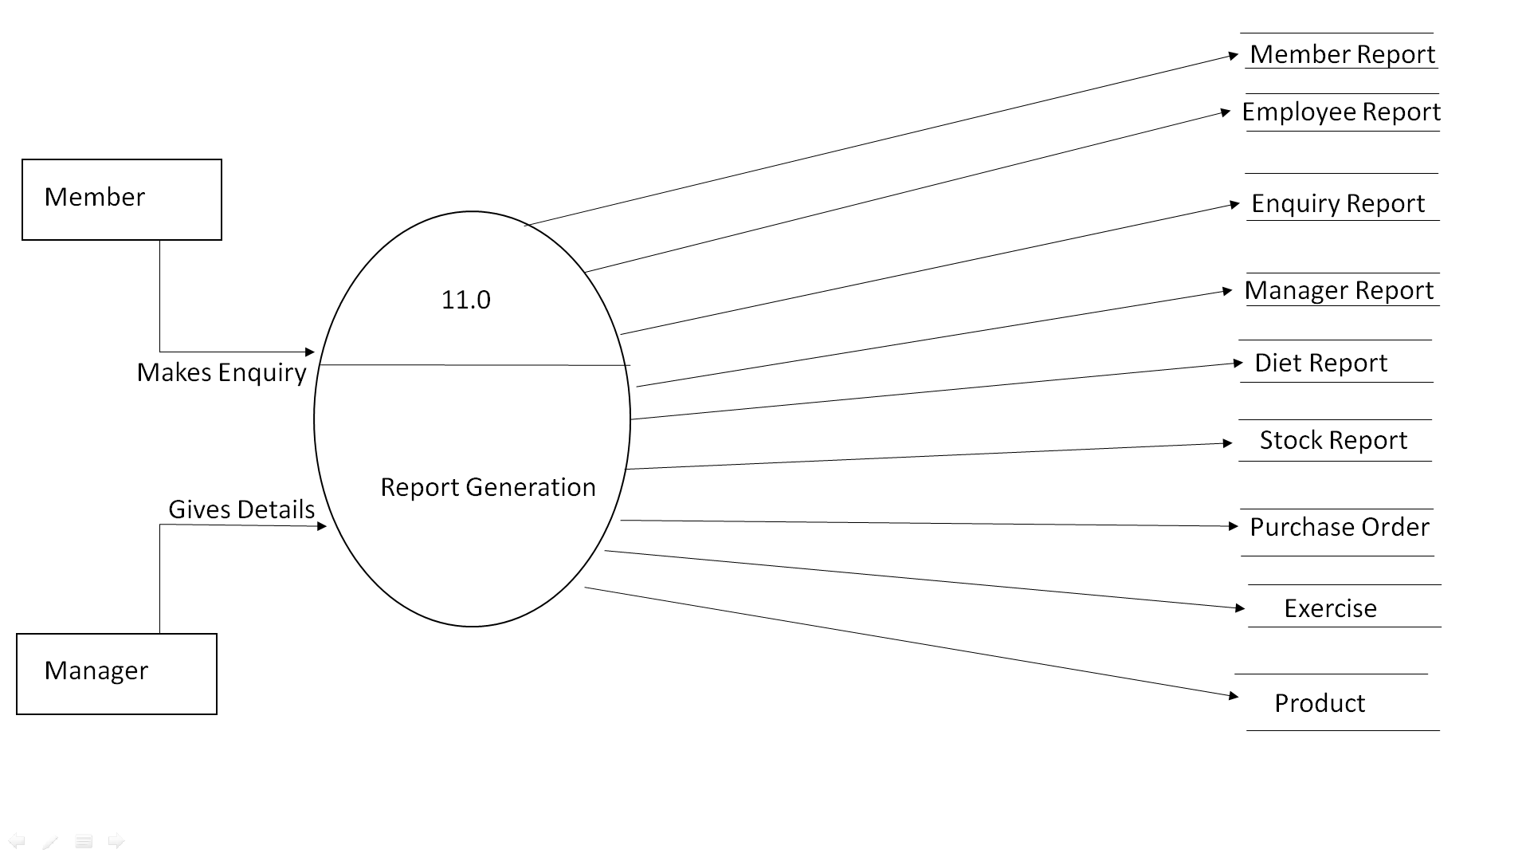
First Level Data Flow Diagram

Slide 19
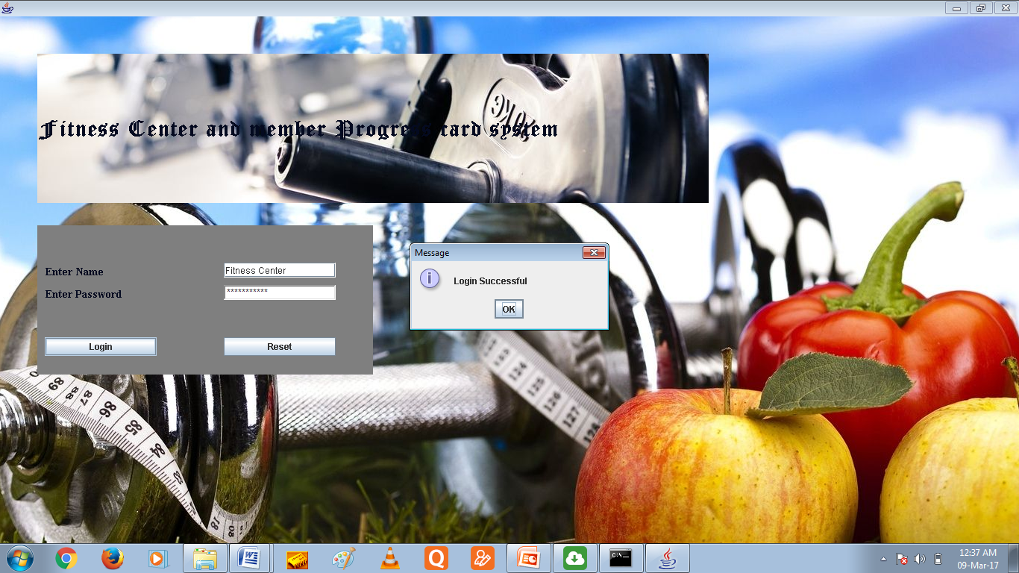
Login Form

Slide 20

MDI form

Slide 21
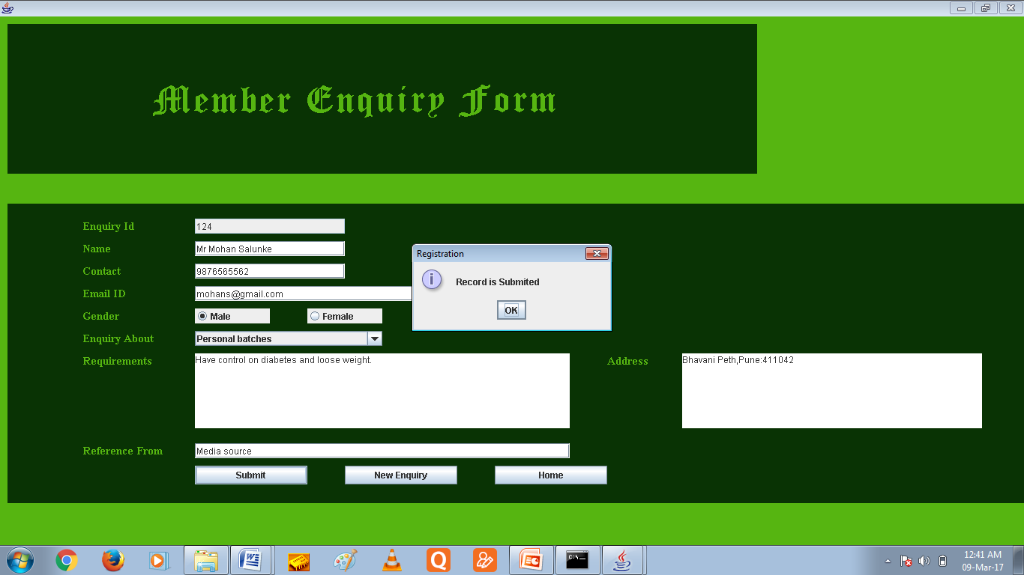
Enquiry Form

Slide 22
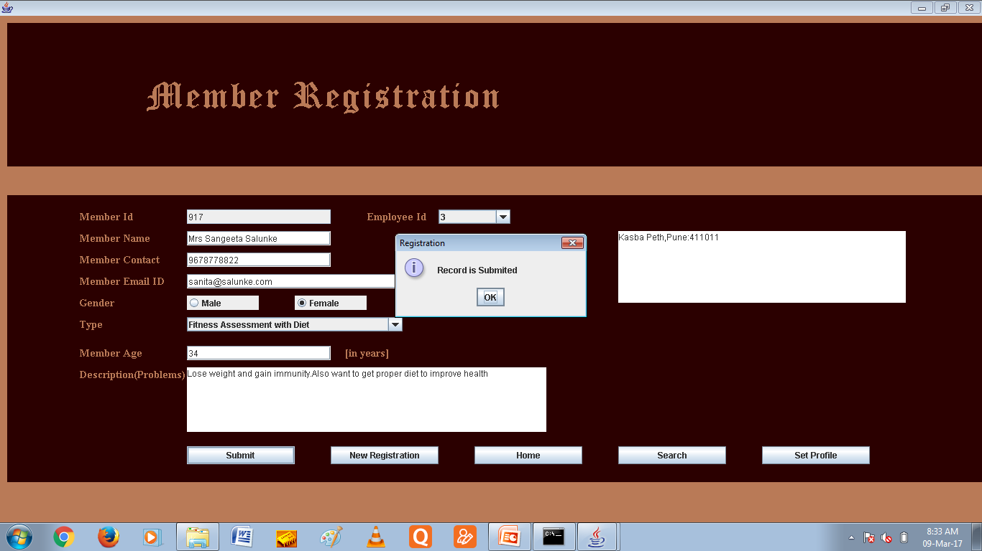
Member Registration

Slide 23
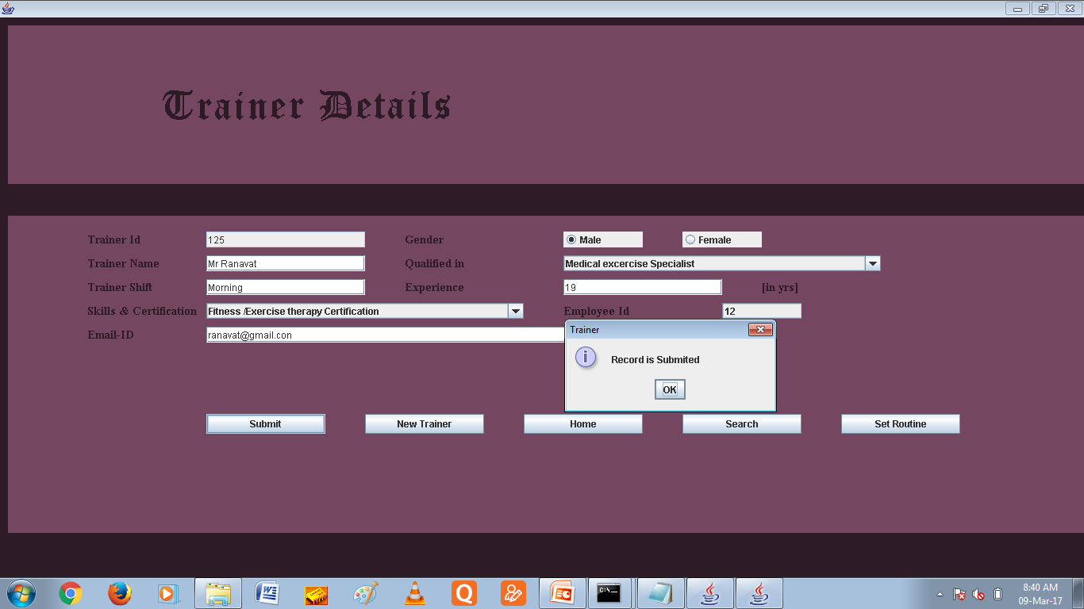
Trainer

Slide 24
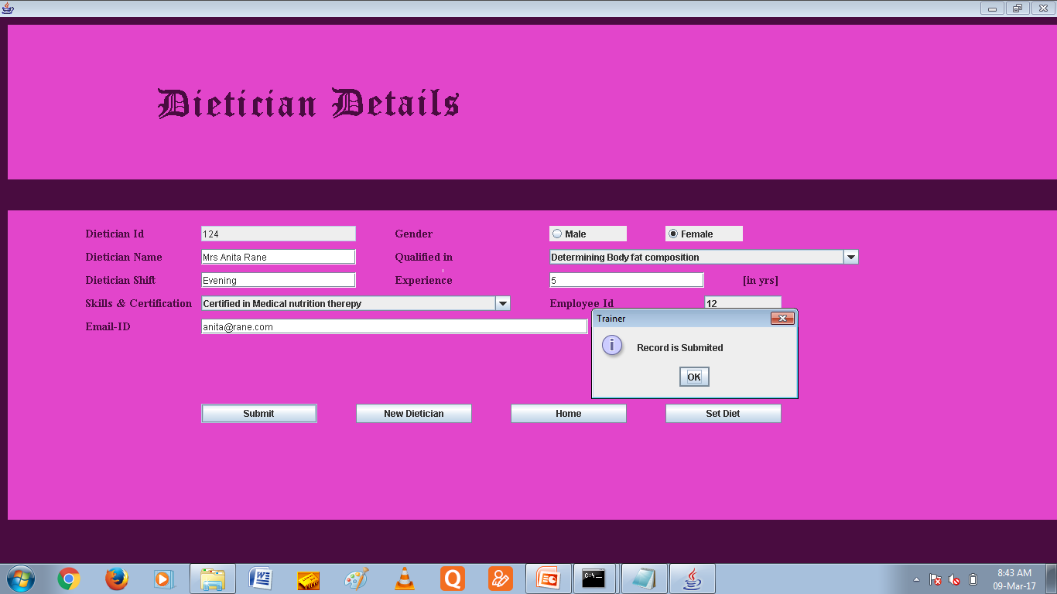
Dietician

Slide 25
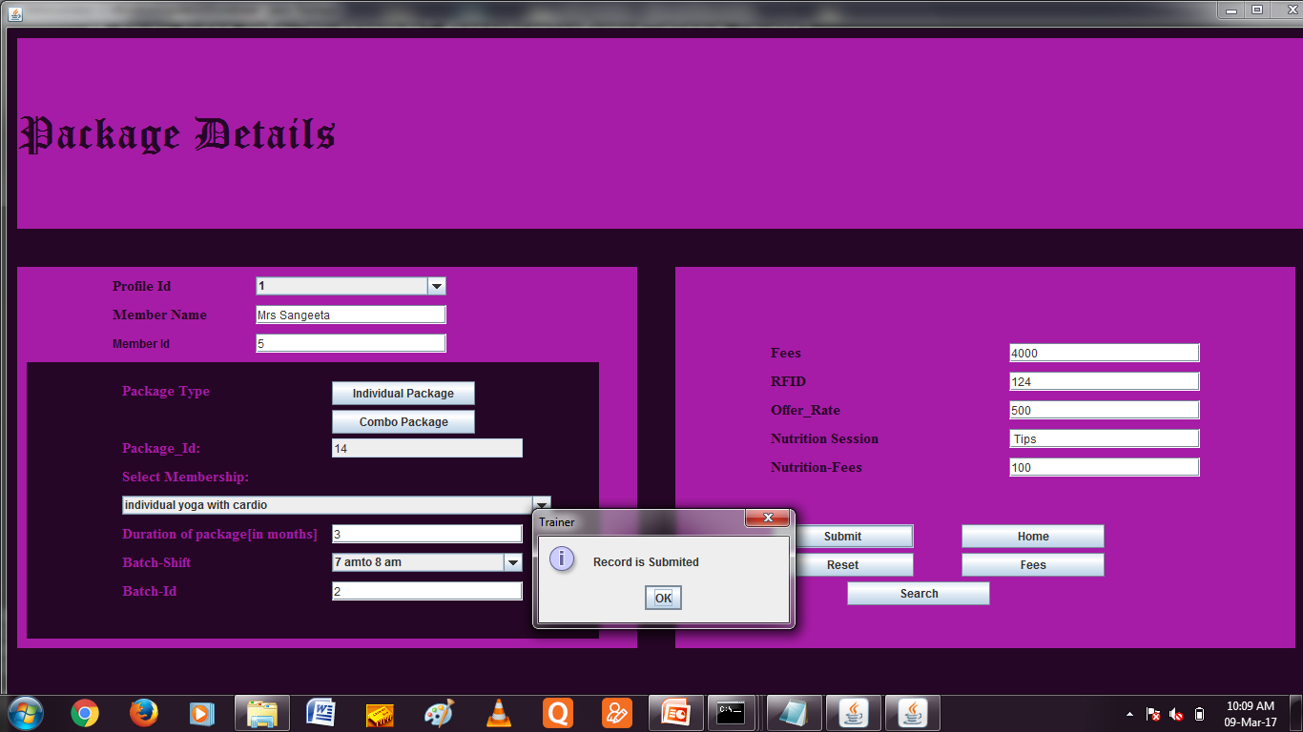
Package

Slide 26
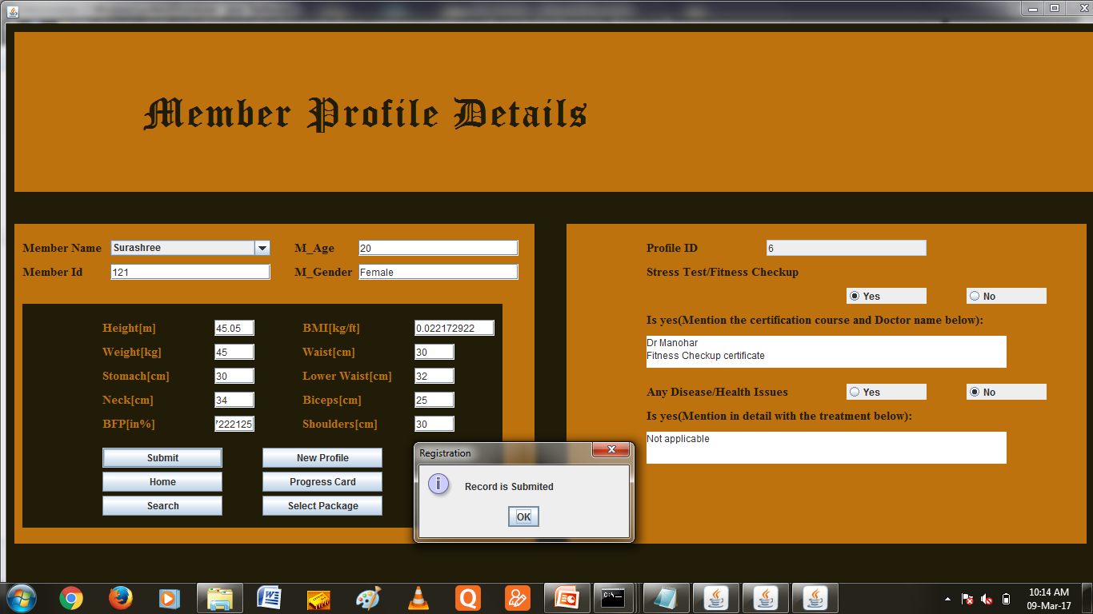
Profile

Slide 27
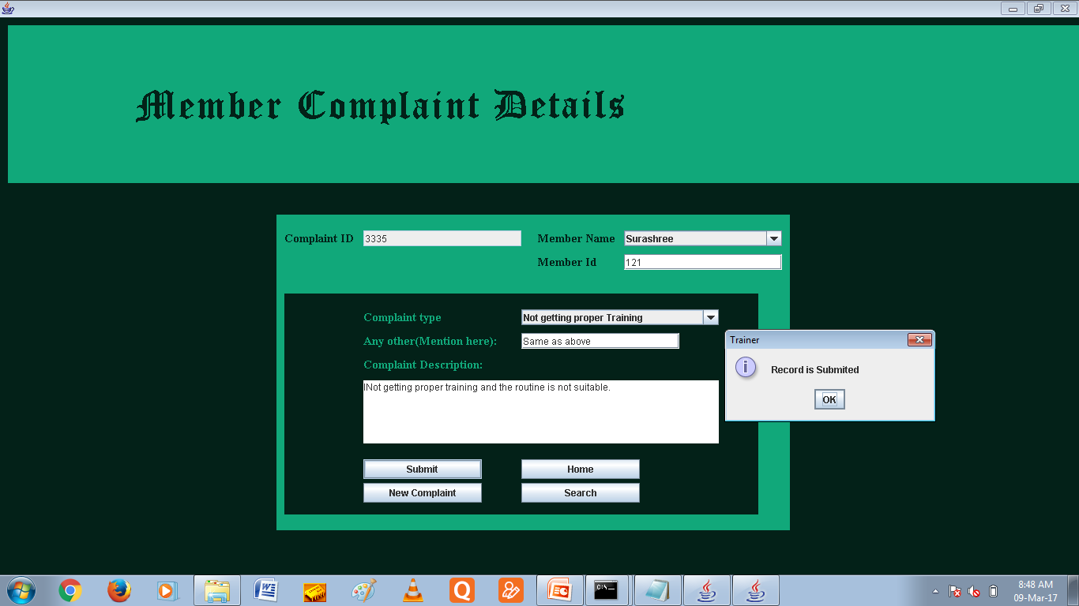
Complaint

Slide 28
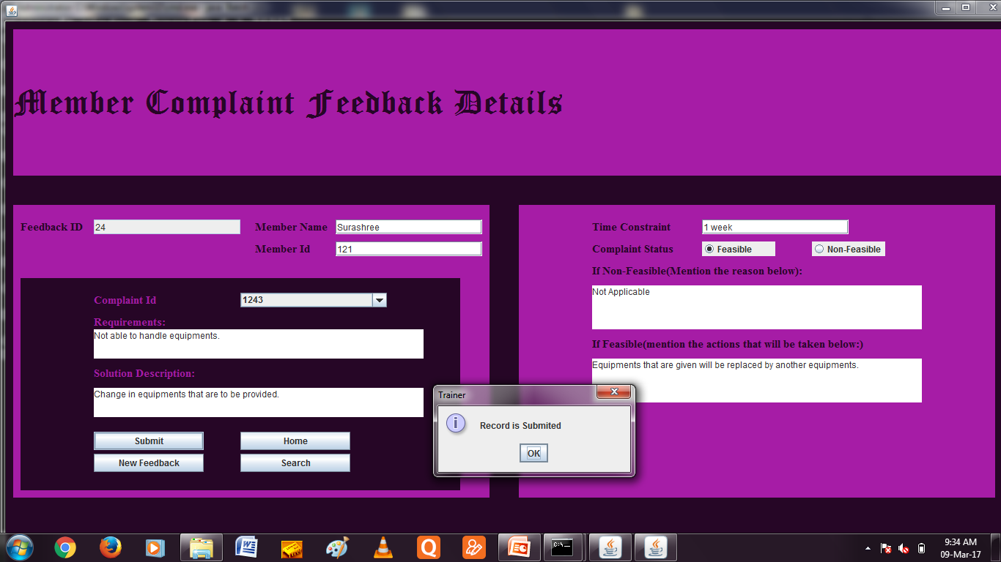
Complaint Feedback

Slide 29
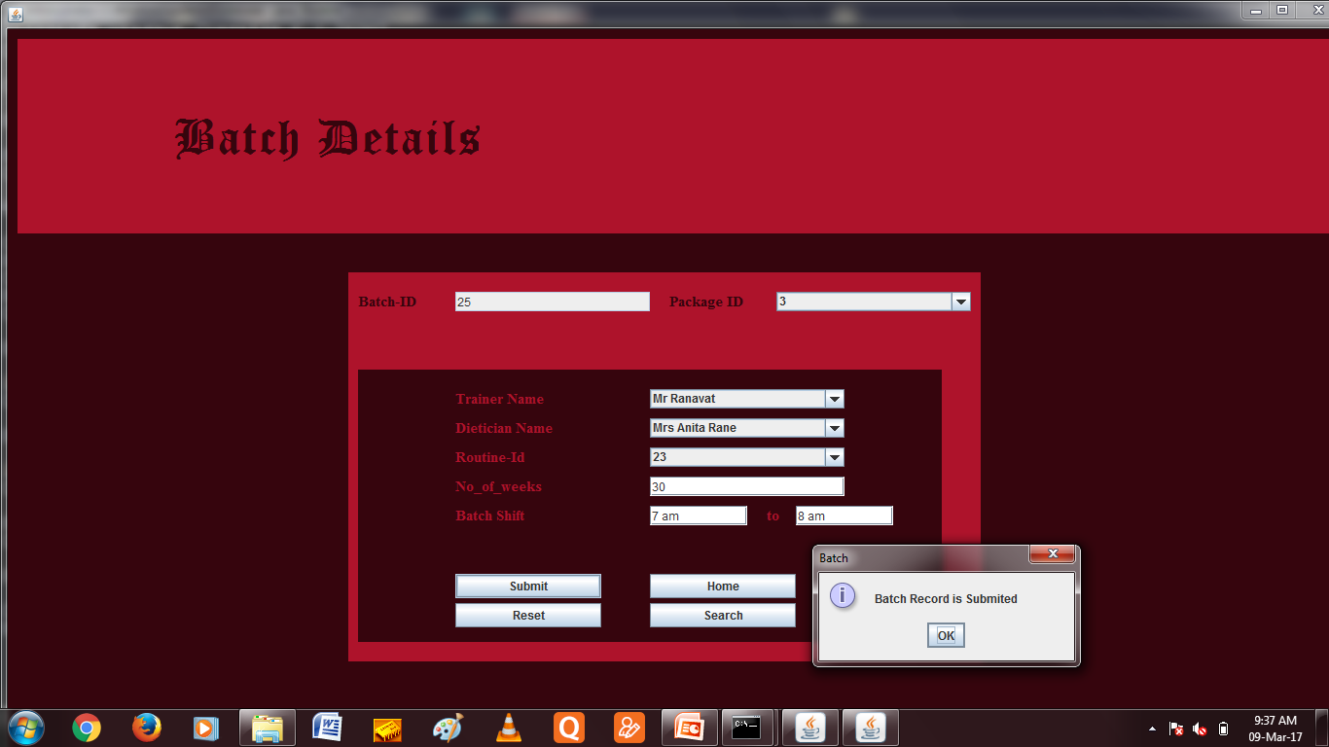
Batch

Slide 30
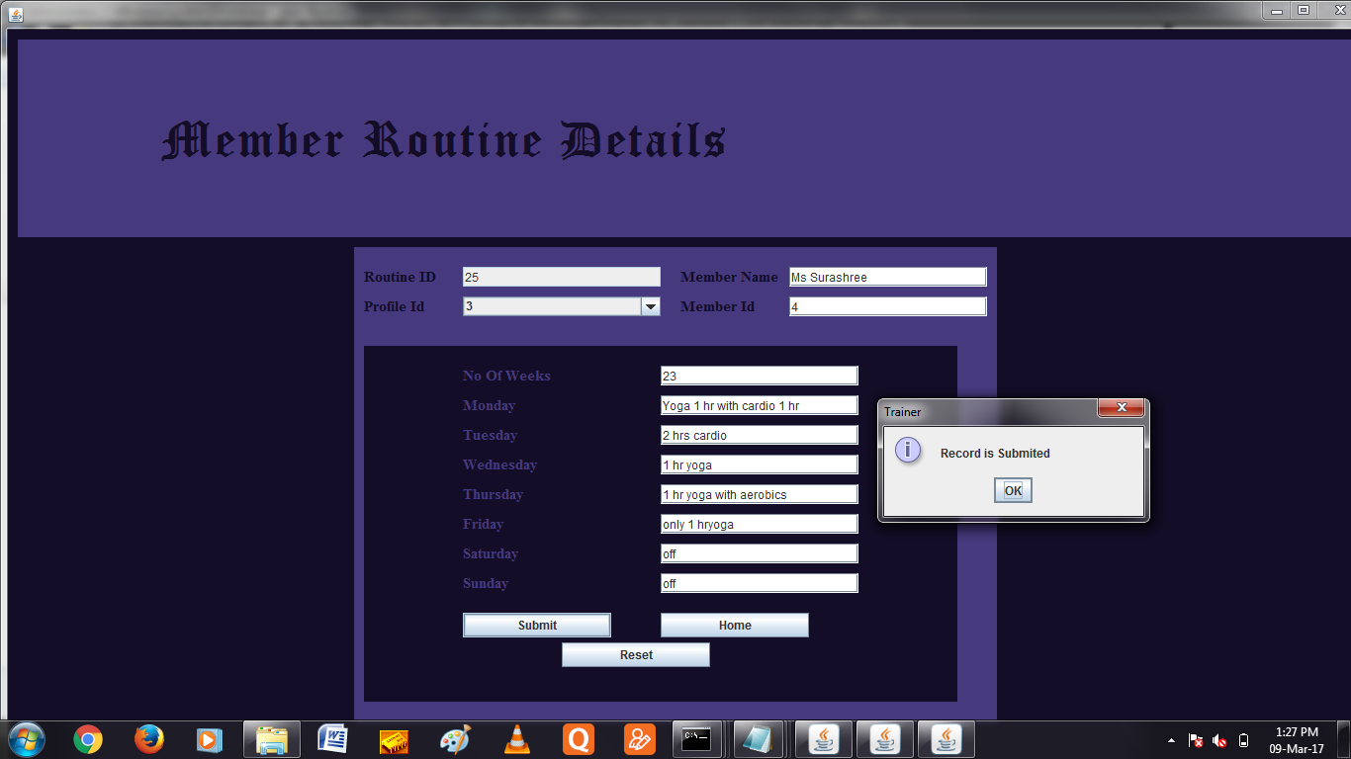
Routine

Slide 31
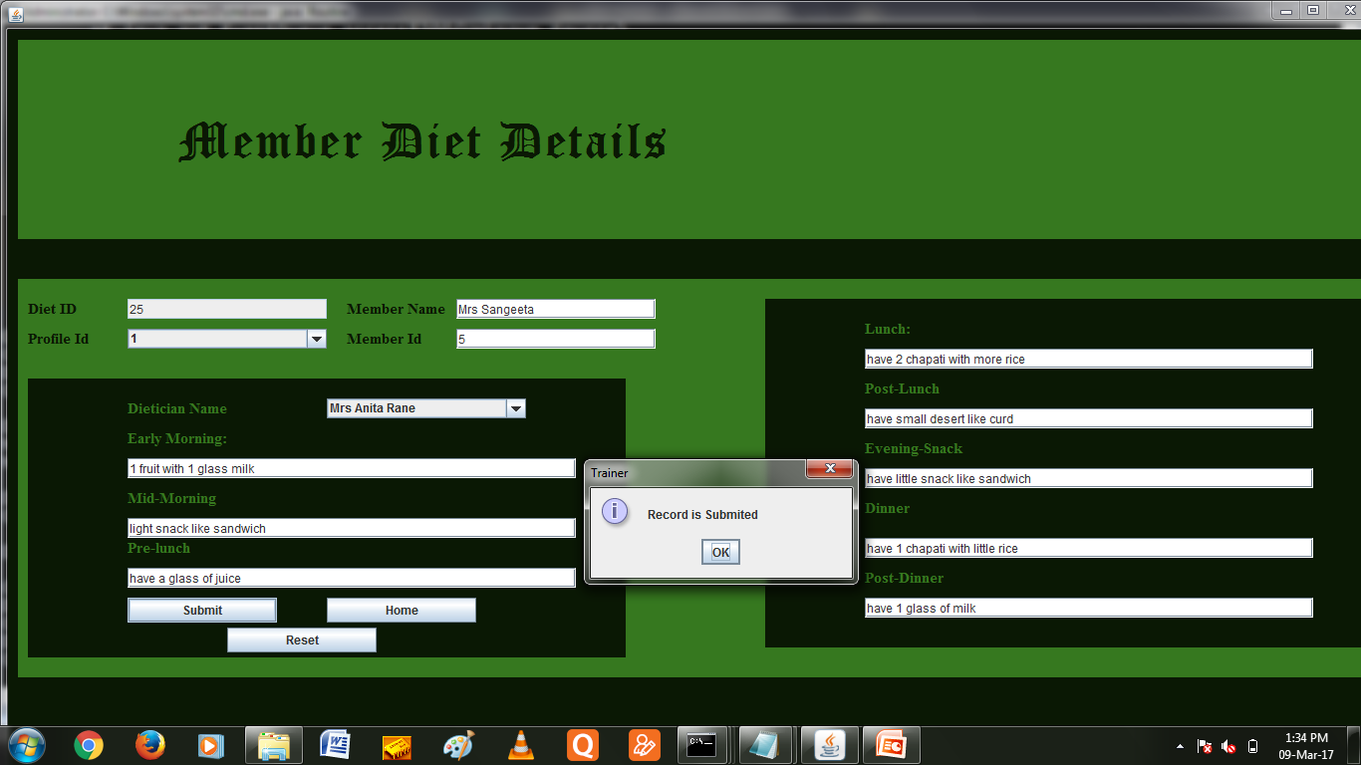
Diet

Slide 32
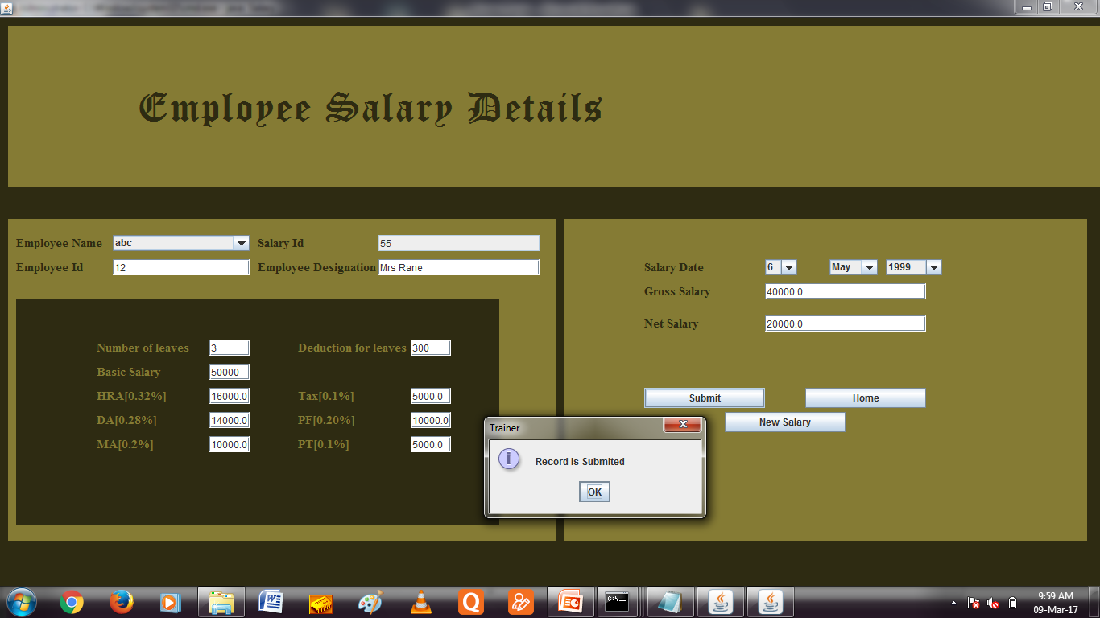
Salary

Slide 33
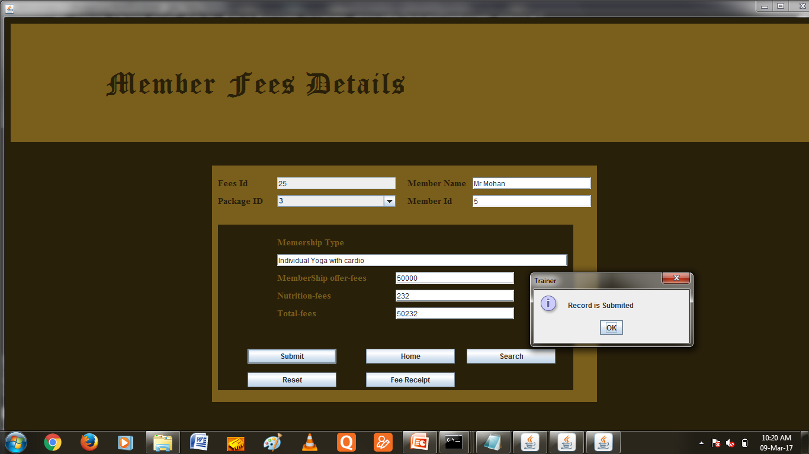
Fees

Slide 34
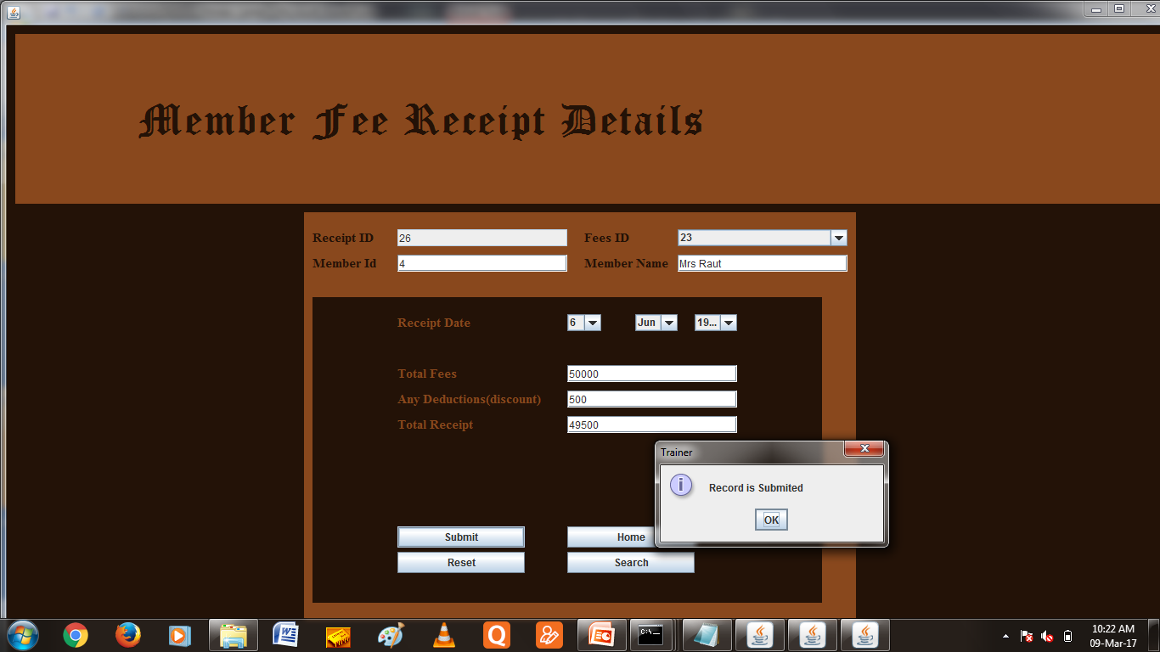
Fees Receipt

Slide 35
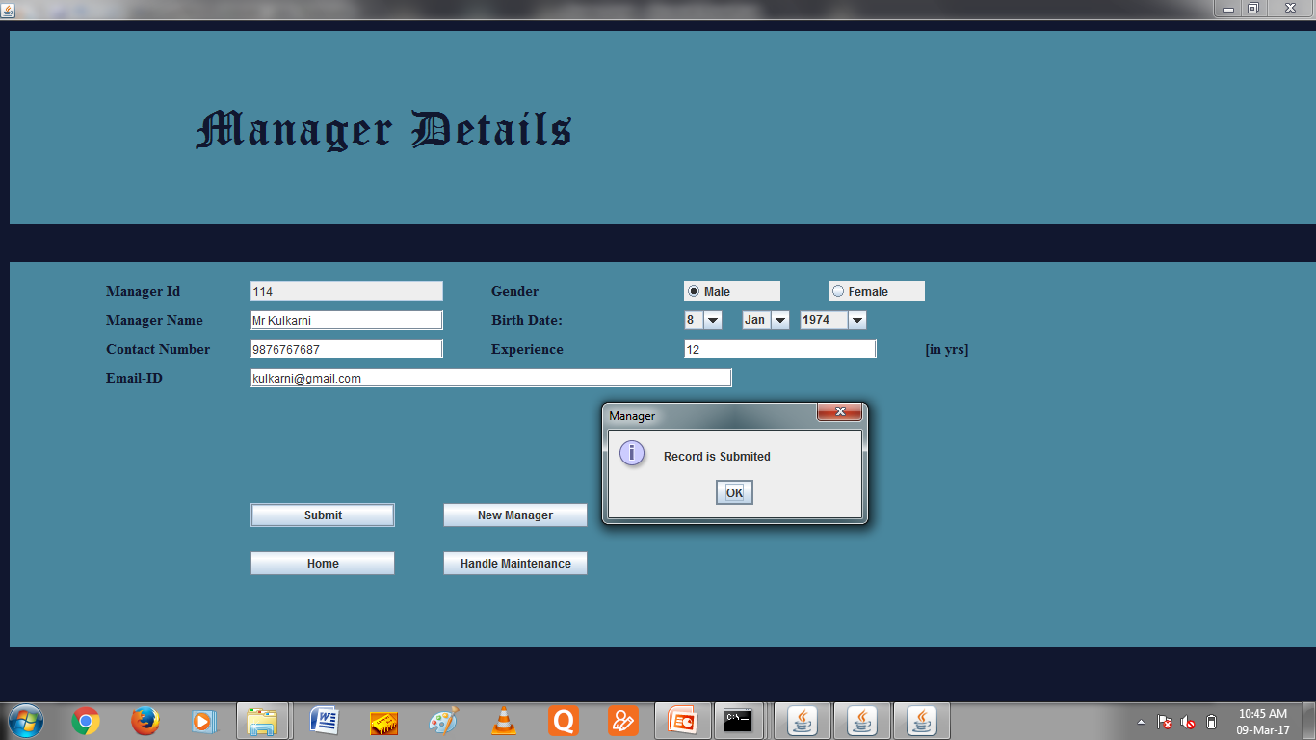
Manager

Slide 36
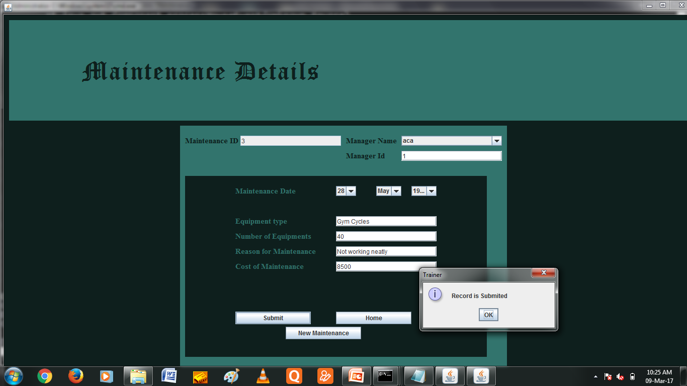
Maintenance

Slide 37
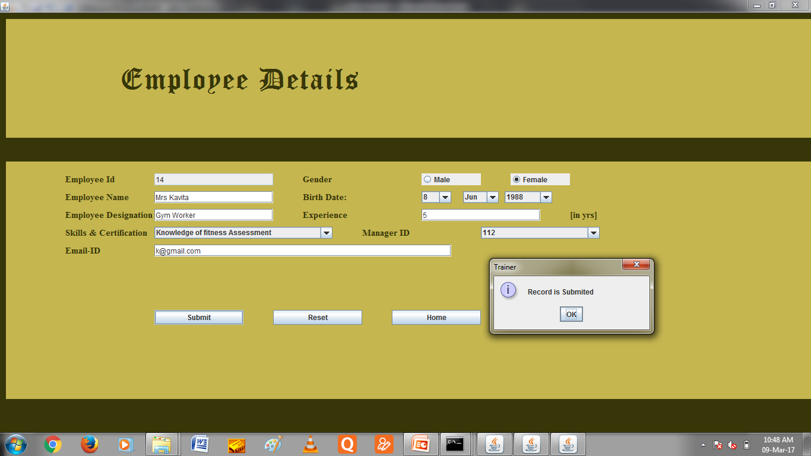
Employee

Slide 38
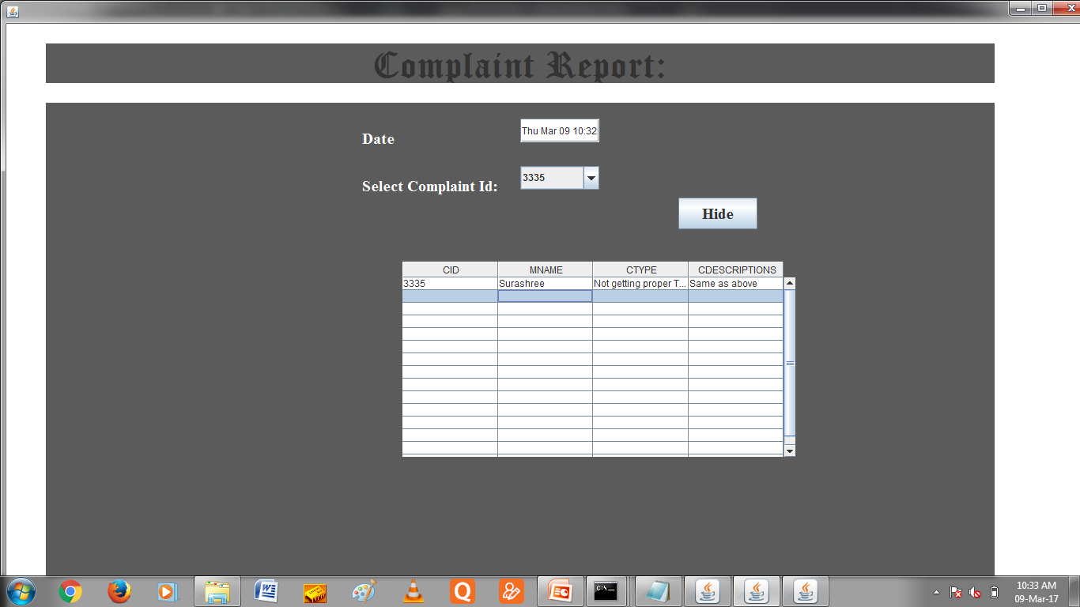
Member Report

Slide 39
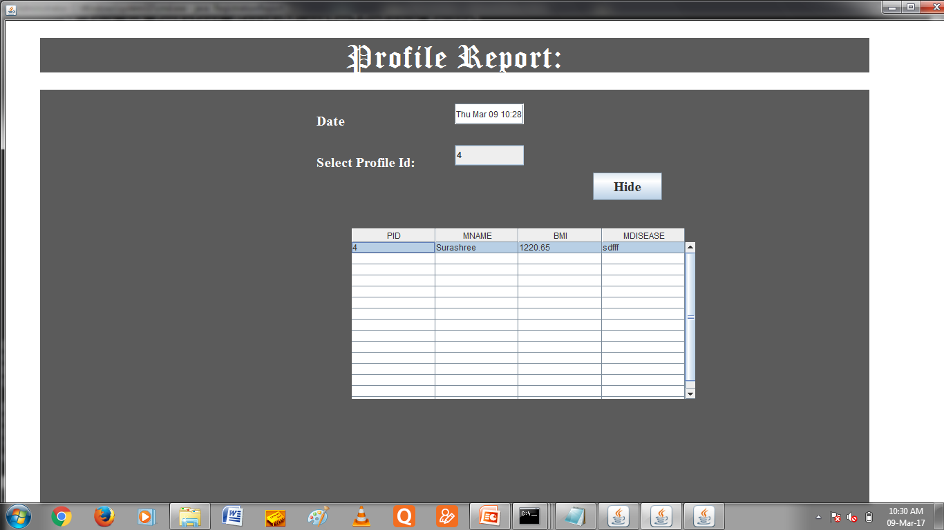
Profile Report

Slide 40

Member Report

Slide 41
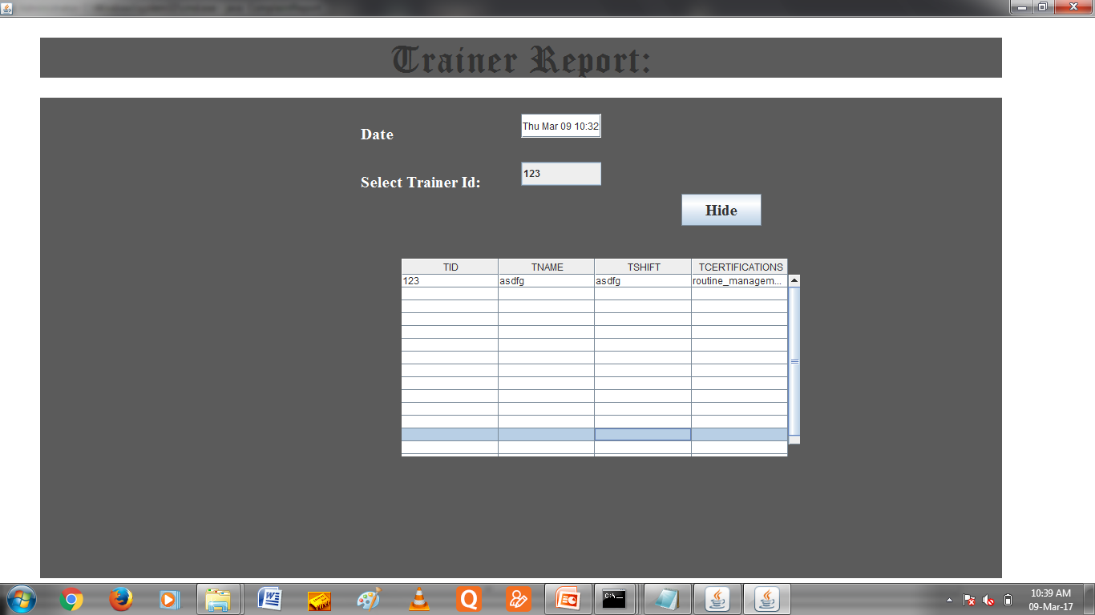
Trainer Report

Slide 42
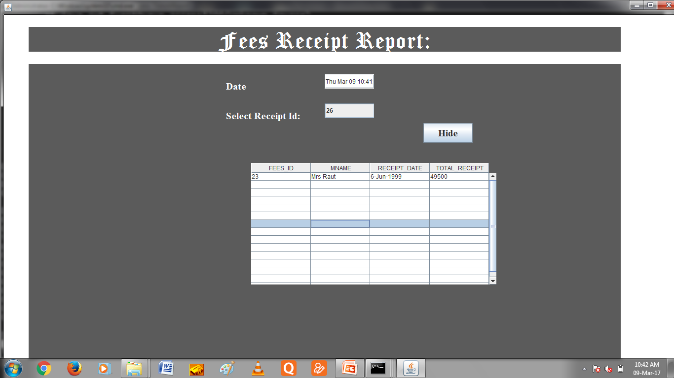
Fees Receipt Report

Slide 43
Features of System
Authorization of data provides security.
Records can be accessed relatively more faster.
Maintains all the details of external entities.
Less Manpower is required.
Needs less manual Efforts.
Member complaints are handled efficiently

Slide 44
Advantages & Limitations
ADVANTAGES:-
Reduce paper work.
Increase Member Satisfaction.
Easily access and storage of huge amount data.
Increase in Member interaction.
Save time.
Increase efficiency.
Authorization of data provides security.
Maintains all the details of external entities.
Less Manpower is required.
Needs less manual Efforts.
Member complaints are handled efficiently
Limitation:-
System handled by only one user.
Online communication is not possible.
Updating of records and deleting unnecessary records is not possible.

Slide 45
Future Enhancement
System can provide virtual training and exercise learning programs.
In can be further developed as an online application to make it more efficient, quick and easy to use.
System can be provided with backup facility to reduce the efforts in case of unexpected error like server down.
System can be converted to multi-user platform with sophisticated security checks.

Slide 46
THANK YOU

